Slide 1
Chapter 4: Service Levels

Slide 2
Network Design Service Level
The term “Service Level” is used too much without a definition
It has many different meanings
Unclear definitions do not lead to clear solutions
Valid definitions for network design
Average distance to customers
Percent of customers within a certain distance
Definitions not applicable to network design
Fill rate
Late orders
Valid service level constraints
Maximum distance to a customer

Slide 3
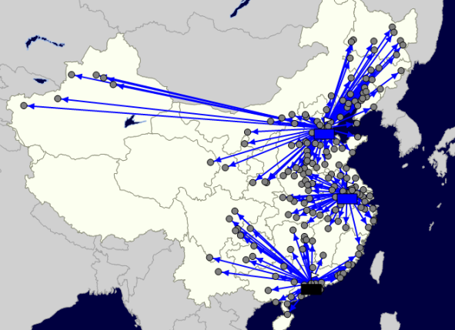
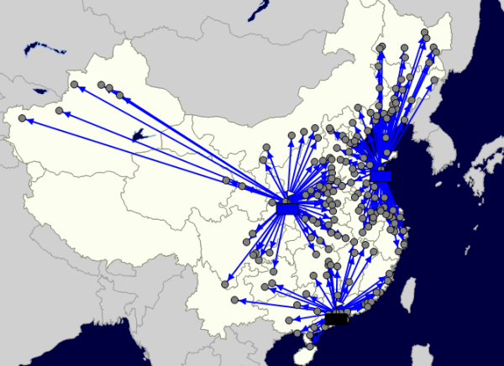
China Scenario Results
Objective 1: Offer the best service possible to the customers who purchase the most
Objective 2: Maximize the demand you can service within 800km/2 Day Service

Slide 4
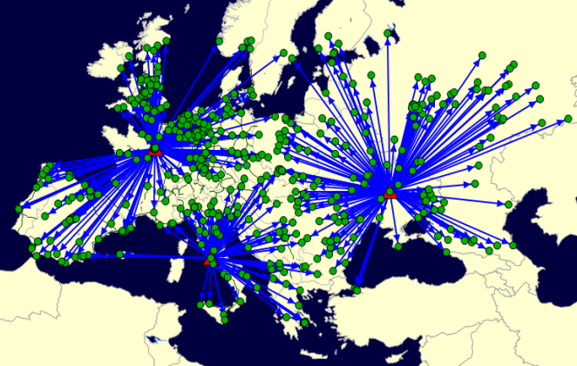
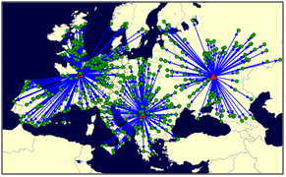
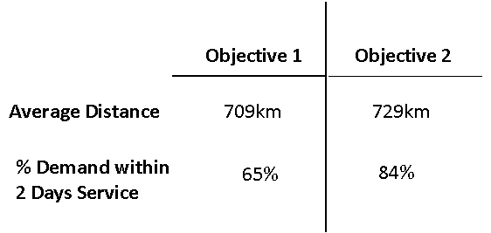
Europe Scenario Results
Objective 1: Offer the best service possible to the customers who purchase the most
Objective 2: Maximize the demand you can service within 800km/2 Day Service
Selects:
Paris, France
Rome, Italy
Kremencug, Ukraine
Selects:
Paris, France
Belgrade, Serbia
Voronezh, Russia

Slide 5
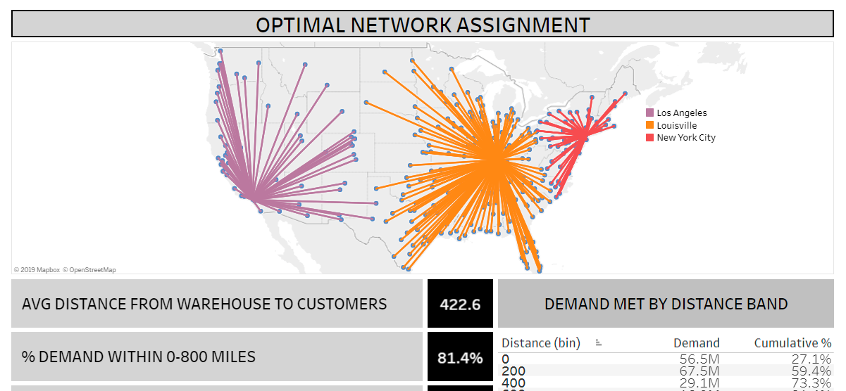
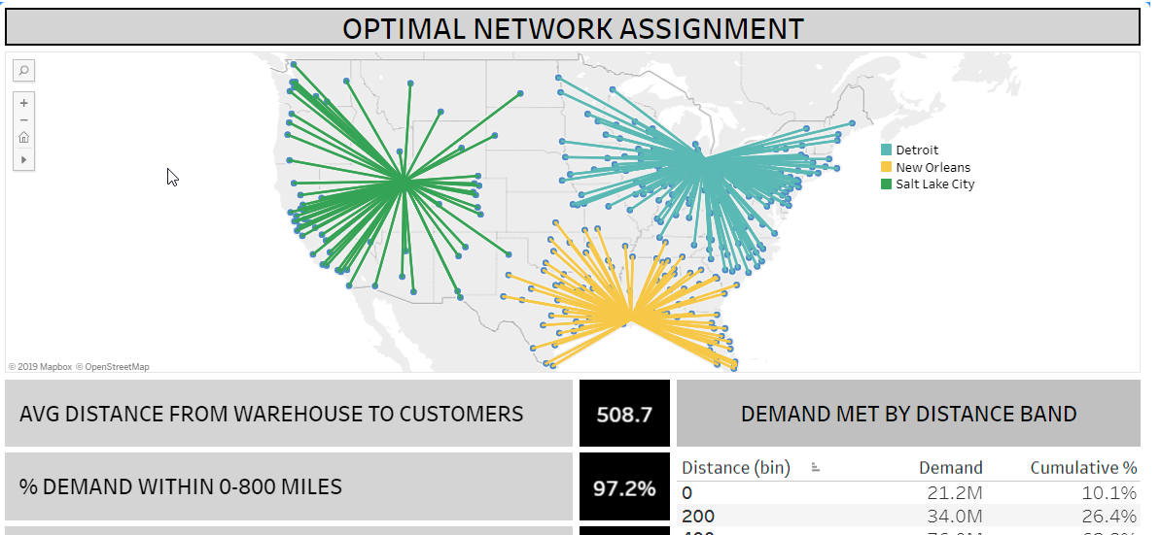
Which is the same as this one…

Slide 6
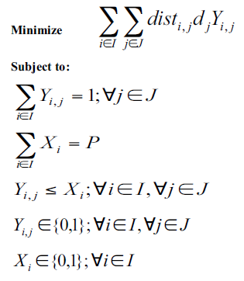
Reminder: this object is just our minimize distance

Slide 7
We need to learn how to do this 2nd objective

Slide 8

Math Formulation for Maximizing Demand within a Given Distance
To maximize the demand within a given distance, we change our objective function to:
Didn’t I say If-Statements are bad??
We are maximizing now
The objective still sums up over all customers and facilities
This is just an expression that says for every i,j combination, we test whether the distance is greater than HighServiceDist. If it is, we give it a 0. A 0 is bad b/c it says that if this combination is used it adds nothing to our objective (it adds zero). If it is within the HighServiceDist, then we get a 1 and if this combination is used it helps the objective function. This expression is nothing more than a new input file
In the end, we are just multiplying the demand by whether we made the assignment. If the previous term is a 0 the objective function gets no credit, so it has incentive to find a 1 from the HighServiceDist matrix

Slide 9

New Constraints for Service
If you don’t specify any other constraints, the customers that are outside of the HighServiceDist will be assigned randomly (there is nothing to direct the optimization otherwise)
The AvgServiceDist constraint can help:
This is the same as our objective when minimizing the total weighted distance. This is simply the distance multiplied by the demand for each assignment. (If we divide by the total demand, we get the weighted average distance.)
The AvgServiceDist is just a factor. This factor is then multiplied by the sum of the demand. The end result is a single number that can be compared to the total weighted distance (except here we are using a single number instead of the average).
If you set the AvgServiceDist factor relatively tight, this constraint will clean up the solution by making sure customers are assigned to the closest open warehouse.
But, note, this is not that easy to do. And, it isn’t that powerful. But, we use it later.

Slide 10
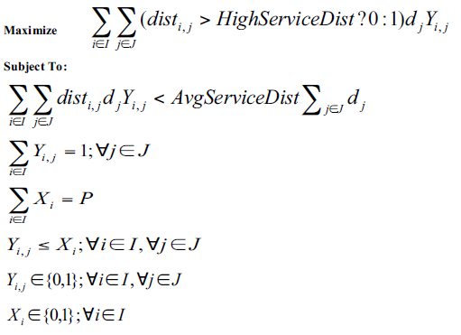
Full Formulation

Slide 11
Setting a Maximum Distance Restriction
Sometimes it is helpful to set an overall maximum distance for any customer (you can do this by types of customers if you want). Here is this family of constraints:
These constraints are going to control the legitimate values of Y_{i,j}
We read this just like the previous example. the MaximumDist is just a factor that we input. If the distance from i to j is greater than this factor (meaning it is further than we will allow), then we assign this term a 0. If it is less than or equal to it, then it is assigned a 1.
When it is assigned a 0, this constraint means that Y_{i,j} must also be 0 (and thus not allowing customer j to be assigned to facility i). If it is a 1, it means that there are no restrictions on Y_{i,j} because Y_{i,j} can only be 0 or 1.
This indicates that we have a family of constraints. A constraint for every combination of i and j.

Slide 12
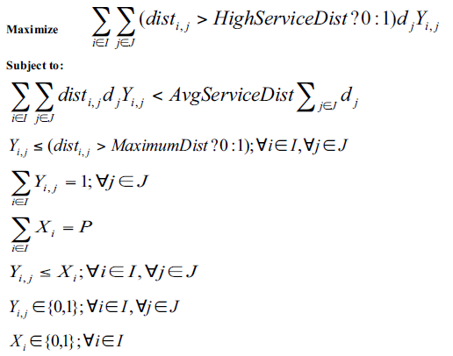
Formulation with Max Distance Constraint
Quick note: These two constraints together can cause problems

Slide 13
Formulation with Max Distance Constraint
We have a problem!
The AvgServiceDist constraint really doesn’t prevent the random assignment of customers (that are either out of radius or within)

Slide 14
Formulation with Max Distance Constraint
To solve this, we are going to run this model first, and then have another model come in and clean up the result.
This is nice for this problem and a good general approach.

Slide 15
Let’s See What this Looks Like in PuLP
This line of code, which is in the data block, shows the “if-then” statement
You’ll get to play around with this in the lab to understand it better

Slide 16

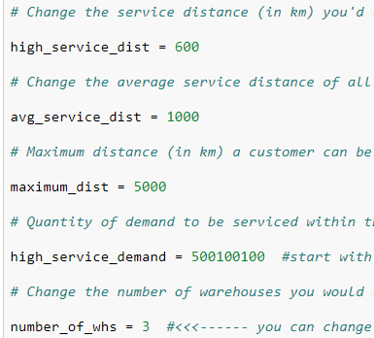
Running the 1st Model in PuLP
In the last block of code, let’s keep the 2nd model commented out….
Let’s set the defaults to the following… And, then Run-All

Slide 17
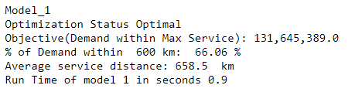
Model #1 Results
Remember, how are customers assigned to warehouses? (those within the max service and those outside)?

Slide 18
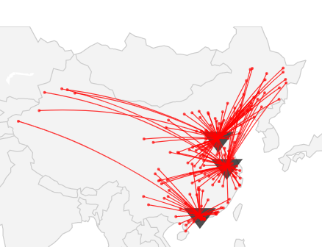
Model #1 Results
Remember, how are customers assigned to warehouses? (those within the max service and those outside)?

Slide 19
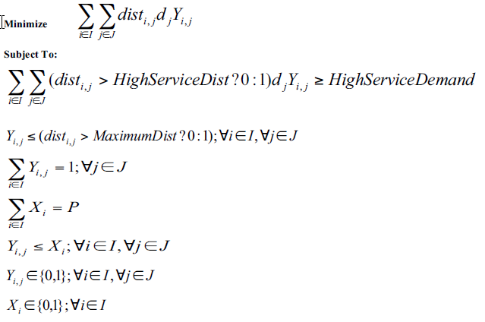
Clean Up Model Trick– Same as Avg Dist Model, but move HighServiceDist to a Constraint
HighServiceDemand is an input. This is the trick.

Slide 20
Let’s Activate the Clean Up Model
In the last block of code, activate the 2nd model
There is a key parameter we need to change here...
What should this number be? Hint: It is from the first model

Slide 21

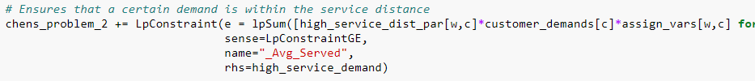
Let’s Review the 2nd Model
The objective function.. Just minimizes distance
This is the key constraint to relate back to 1st Model
What is the parameter you need to update??

Slide 22
What is the trick?
Let’s explain intuitively how this cleans up the solution
The constraint forces at the solution to be as good as the previous (and it won’t be better- or the other model would have found it. And, then the rest of the problem minimizes the distance by making the closest assignments!

Slide 23
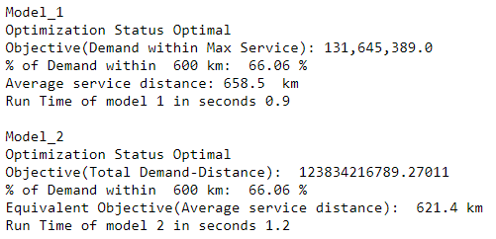
Results
In Model 2, How did it the % of Demand within 600 km stay the same??

Slide 24
Model Clean-Up Steps-- Review
1. Run this model and note the answer (as HighServiceDemand). This is the most demand you can meet in the service distance.
2. Now run this model. The constraint basically makes sure that the same facilities are picked and they have the same assignments as before (barring multiple optimal solutions). But, the objective will assign all the remaining demand to the closest facility.

Slide 25
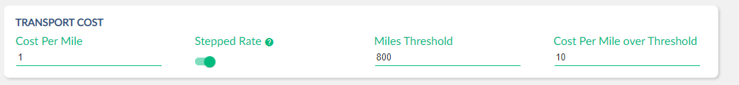
How Would You Compare These Models?
Earlier, we used this simple model. We tricked the distance, up to 800 miles, we used $1/mile after 800 we used $10/mile. We manipulated the distance matrix.
The model we just covered
versus
How would you compare and contrast these approaches?
Work-around, but easy model; No work-around, but a little harder

Slide 26
End of Section

Slide 27
Chapter 4: Better Modeling with Metric* Variables *others may use different terms

Slide 28
Insights from the Full Formulation
How can we think about constraints above and below the line?
Above: Kind of like objectives or goals
Below: Logical, physical constraints
This might go above too

Slide 29
Going from Model 1 to Model 2, we just swapped objectives and constraints
Model 1
Model 2
In Model 2, we carefully set the new constraint value

Slide 30

Better Engineering Our Models
“We should bring ideas from Computer Science to our optimization models”
Pete Cacioppi

Slide 31
Better Engineering Our Models
We should use names that have meaning
We should not worry about formulating our models with the minimum number of variables and constraints
Extra constraints can help model run time
Extra constraints and variables can make the model more robust and readable
Metric variables can make the model more flexible
Commercial solvers can take care of translating to the MIP engine

Slide 32
Chapter 3 and Chapter 4 Models
We have different criteria to judge models
Average distance
Max within a threshold
Overall max of a lane
We have constraints that define the business rules or underlying validity of the model

Slide 33
For each of our Objectives or Goals: We can create a Metric Variable

Slide 34
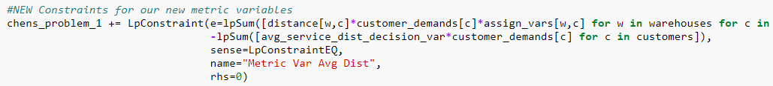
We Can Then Use a Constraint to Set the Metric Variable
It is important to understand what this constraint is doing:
What does this constraint do?
What does it do in terms of impacting the business solution?
It is only setting the value of the metric variable. It is not impacting the decision, doesn’t guide the solution in any way, it just sets the value of this metric.

Slide 35
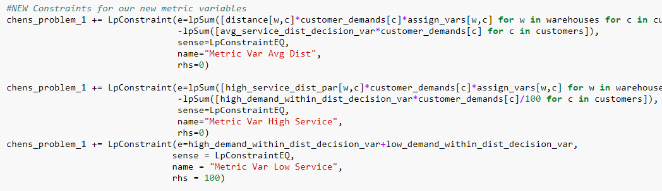
Constraints for Metric Variables in PuLP

Slide 36
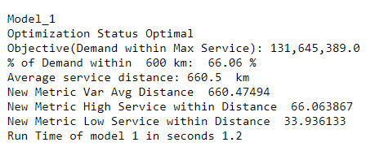
Makes Reports Easier

Slide 37
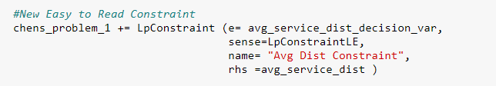
Makes Model Building Easier

Slide 38
Take it a Step Further to Create Fully Flexible Model
Minimize Sum of:
w1 x Avg Dist Metric Var +
(1-w1) x Cust Outside Service Metric Var
Then toggle the weights between 0 and 1… or (hint: use combinations of the weights… that leads us to multi-objective)

Slide 39
End of Section

